Slide 1
Oyénte: Making Smart Contracts Smarter
Loi Luu
National University of
Singapore
Duc-Hiep Chu
National University of
Singapore
Hrishi Olickel
Yale-NUS College
Prateek Saxena
National University of
Singapore
Aquinas Hobor
National University of
Singapore
Notes:
Expand the Motivation - More on Ethereum,
Need to pick a message and stick to it
Less emphasis on the specific bug
Move from cryptocurrencies to smart contracts
Show ThDao Bug
incentives for malicious behavior
contribution:
1. Identified the major bugs.
2. Automated Detection
3.
motivation - contributions - attacks -
Do only one attack really well

Slide 2
Background
Cryptocurrencies
Introduced in 2009
Bitcoin, Ethereum
Over 11 billion USD
P2P Payments
Automated Transactions
Smart Contracts
Notes:
Cryptocurrencies were first introduced to the world in 2009, through a digital currency that we know as Bitcoin. They operate on a decentralized network model, where transactions are performed and verified by nodes on a network, with no centralized/trusted parties. Since then, they have grown in number and volume, with the two most popular currencies - Bitcoin and Ethereum - currently operating at a market capitalization of 10 billion and 1 billion USD respectively. Originally introduced for peer-to-peer payments, they were soon explored as an avenue for automated payments - and most recently, for use in Smart Contracts.

Slide 3
Smart Contracts
...
// Burn DAO Tokens
Transfer(msg.sender, 0, balances[msg.sender]);
withdrawRewardFor(msg.sender);
totalSupply -= balances[msg.sender];
balances[msg.sender] = 0;
paidOut[msg.sender] = 0;
return true;
}
Introduced in 1994
Ethereum (2014)
Over 19k contracts
Example - Solidity
Issues
Permissionless Network
Anonymous Participants
Locked Currency
Immutable contracts
TheDAO
Largest crowdfunding in history
$160m USD in Capital
$50m lost.
Notes:
A Smart Contract is a computer program that encodes the rules and conditions of a contract in such a way that the contract can be executed and verified in an automated fashion. Originally introduced by Nick Szabo in a 1994 paper, they have seen adoption in both private and public settings.
The major introduction for smart contracts to the world came from Ethereum - a cryptocoin focusing primarily on executing turing-complete smart contracts on
the blockchain. After one of the top 10 most most-valued crowdfunding campaigns of all time in 2014, Ethereum currently has over 17000 smart contracts.
Smart Contracts have been proposed for a multitude of applications, ranging from simple micropayment systems and automated loans to entire decentralized organisations. Here is a snippet of a popular smart contract on Ethereum:
The contract is written in Solidity, a javascript-like language, and this snippet here implements a withdrawal function for investors in this particular contract. As we can see, there is a payout, a global balance being updated as well as an array of local balances in Ether - the currency in Ethereum - to the person making the call. Deceptively simple to understand and implement, this piece of code is then compiled into a stack-based bytecode that is executed and verified by the nodes on the Ethereum network.
Unlike traditional systems, smart contracts are open to attack when operating on a public - permissionless - network, where anonymous adversaries may attempt to exploit their operation. Smart Contracts like this one can come to hold and transact large amounts of capital in their operating life, providing ample financial incentive. This is not accounting for the possibility of bugs in contract code that can lock away any amount of this capital forever irreversibly and irretrievably. In fact, this snippet of code belongs to a popular contract called TheDAO, a decentralized venture capital fund that was launched in May this year with a corwdfunding campaign that turned out to be the largest in history, amassing over a hundred and sixty million USD in capital from over 11000 investors, nearly 14% of all Ether tokens issued. Early June this year, a recursive splitting bug - which we will analyse in detail later - was exploited that allowed attackers to drain over a third of this money - $50 million USD at the time - from the contract.
Talk about upcoming ethereum hard fork due to GAS manipulation?
In this presentation, we will be introducing several new classes of security bugs in Smart Contracts, analysing them on the public blockchain, and how automated detection and improved design can help counter this threat. If we can understand the fundamental flaws in thinking that leads to these bugs, we can arrive at a better model for placing smart contracts on decentralized networks.

Slide 4
Smart Contracts on Ethereum
Launched in 2014
Over $1 billion in Market Cap
~ 19k Contracts (at the time of writing)
Contract implementation is problematic
~ 30m USD connected to problematic contracts
Need to ensure correctness prior to deployment

Slide 5


Consensus on The Blockchain
Decentralized computation
Miners compete to solve a common puzzle
Results verified by all miners
f(x)=y
Proof-of-Work
BlockChain
Solution

Slide 6
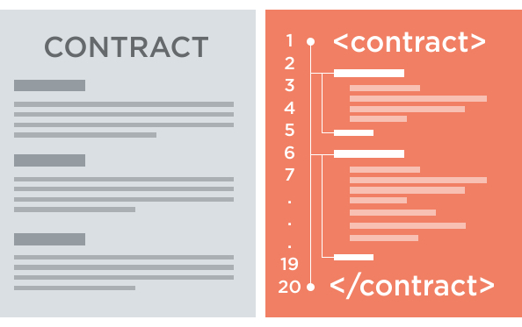
Smart Contracts on Ethereum
Contract execution
Computational Consensus
Failed Execution
Computational Costs
Scripting Languages
Solidity
Serpent
Blockchain

Slide 7
Contributions
Oyente
Smart Contract Analyzer
Automated Bug Detection
Implementation – http://oyente.github.io/benchmarks/
Etherlite
Improved Semantics for Smart Contract Execution
Improved Security on existing source code
Notes:
We introduce Oyente, a smart contract analyer that is capable of detecting the bugs being discussed today, with a false positive rate less than 7%. The code has been open sourced, and is available for easy download and evaluation at this link.
We also introduce Etherlite, an improved version of Ethereum that patches these issues without needing to modify existing contract code.

Slide 8
Problem

Slide 9
Why
Semantic Gap
Expectations vs. Reality
Increased Abstraction
False sense of Security
Notes:
Why are these problems prevalent?
We believe that these flaws arise in practice due to a semantic gap - a mismatch in the rational expectations made by the architects of smart contracts and the reality of executing code on a decentralized network.
Moreover, the amount of abstraction provided by the high-level languages these contracts are written in - javascript and python equivalents, for Ethereum - lead to a false sense of security, where underlying operations and security flaws are obfuscated and often poorly understood.

Slide 10
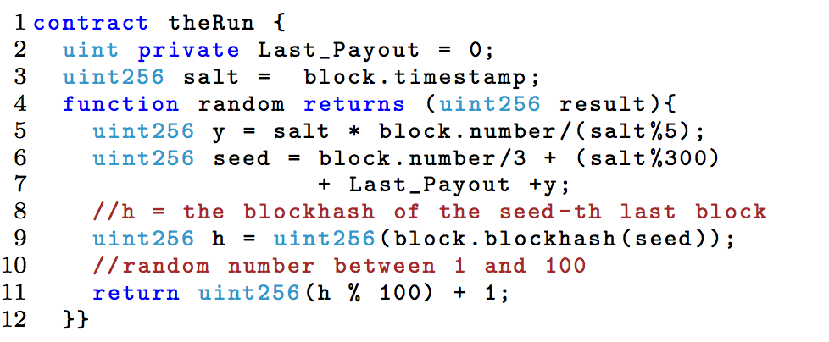
Danger of Abstraction
contract TimedContract {
uint timeout = now + 4 weeks;
}
timestamp variable
Alias for block.timestamp
No real global timestamp
Controlled by miners
Timestamp Dependence
Notes:
Let us consider an example to illustrate the danger of abstracton.
Solidity provides users access to a timestamp from within the contract through the now variable. A sample contract that stores a particular timeout of 4 weeks is shown. The syntax is rather easy to read and implement. The now variable is an alias for block.timestamp, which represents the timestamp of the current block. This has led to contracts such as theRun, which implements a payout controlled by a psuedo random number generator, the code for which is shown.
The function random uses the block timestamp as a salt, which is not uncommon in a traditional program. However, there is no global timestamp in the decentralized network, and the rules governing the assignment of a block timestamp only serve to provide an approximation.
This leaves the timestamp - and by extension, any contracts using it - open to manipulation by the miners. In reality, the timestamp can be changed by as much as 900 seconds by a miner, which allows him/her to manipulate the output of the contract to an advantage.
This introduces what we've come to call timestamp dependence, which is one of the classes of bugs detected by Oyente.

Slide 11
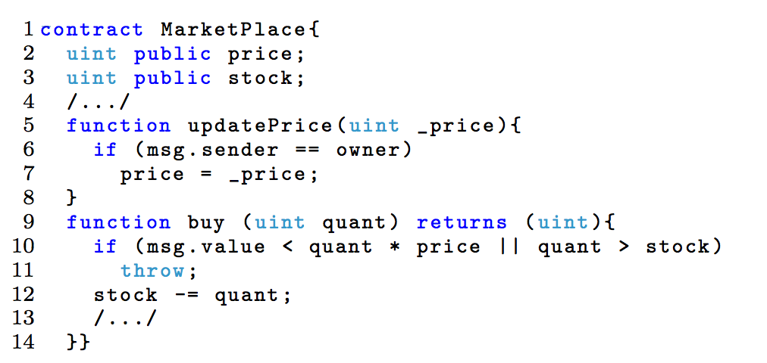
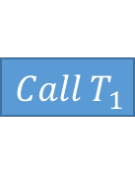
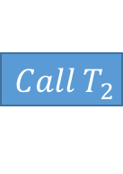
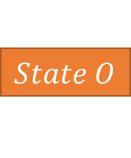
Semantic Gaps
Decentralized marketplace
Buy
Update Price
Atomicity
Buy before Update – true?
TOD Bug
$$Call T_{1}$$
$$Call T_{2}$$
$$State O$$
Notes:
Next, let us look at an example of how a semantic gap can be problematic.
The contract MarketPlace implements a decentralized marketplace. An owner can deploy the contract to sell stocks in an asset, which performs two primary functions - A user can buy any number of available units of stock, and the owner can update the unit price at any time.
In a centralized execution environment such as a web server, there is a a rational expectation that calls are atomic, which is commonly the case when they are completed and served on the order of milliseconds.
On Ethereum, each contract call is a transaction that updates the state of the contract, and many transactions are bundled together to form a block that enforces a state transition on the blockchain. Let us consider how two such transactions would occur -
User A sends a call T1 to buy a 100 units of stock at $1, which is the current value as per the last block.
User B - the owner - send a call to UpdatePrice to update the current price to 0.01 cents, with or without the knowledge of A's transaction.
A block is compiled by a miner once a sufficient number of transactions have been posted, which includes both A and B's transactions. Once the block is mined, their transactions can be considered processed, and the ownership of stock is transferred and the current price updated.
We can see how this is problematic. Even if B's transaction was posted after A's, there is a non-zero probability - even in a fair network - that it will be processed first. This means that a malicious owner can update the price to his advantage after observing a buy order.
It is understandable that a developer unfamiliar with the dynamics of contract execution misses this vulnerability, which we've come to call Transaction Ordering Dependence (TOD).

Slide 12
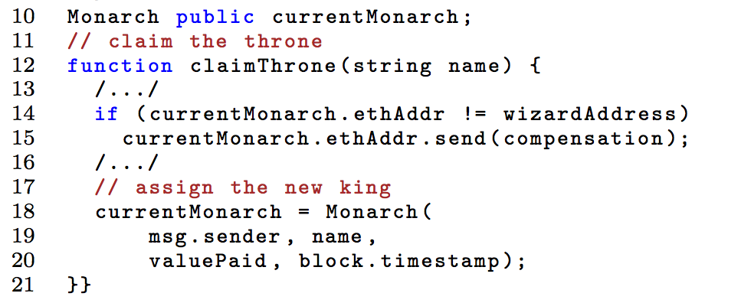

Vulnerabilities in the Platform
Exception Handling
Maximum Callstack size of 1024
Callstack Attack
Mishandled Exceptions
Notes:
Another class of bugs have been previously found that exploit the way exceptions are handled in Smart Contracts on Ethereum.
On the Ethereum network, contracts are allowed to execute in up to a maximum callstack depth of 1024. Attempting to execute a function or contract call at this depth results in an exception. However, this exception is not propagated up the callstack as a default behavior. A contract can ignore the exception, which leads to unexpected and often unfortunate behavior.
Here's an example - this contract implements a government where a user can pay the old monarch to replace him as the current monarch. A monarch can only be displaced once he is compensated for his investment. However, if the user were to call the contract with a carefully constructed callstack of 1023, the payment for the current monarch would not be executed, and the contract would continue to dethrone him.
This is an instance of a vulnerability in the platform that is not apparent to a developer working on the contract, leading to unexpected results.

Slide 13
TheDAO Bug
...
// Burn DAO Tokens
Transfer(msg.sender, 0, balances[msg.sender]t);
withdrawRewardFor(msg.sender);
totalSupply -= balances[msg.sender];
balances[msg.sender] = 0;
paidOut[msg.sender] = 0;
return true;
}
Reentrancy vulnerability
Most expensive vulnerability to date
Recipient is called before balance update
Need for pre-deployment testing
function payOut(address _recipient, uint _amount) returns (bool) {
//...//
if (_recipient.call.value(_amount)()) {
PayOut(_recipient, _amount);
return true;
//...//
}
Notes:
Finally, let us consider the vulnerability popularized by TheDAO contract we briefly covered at the beginning. This has been the single largest instance of a smart contract bug - in terms of monetary loss - with the amount lost from TheDAO being larger than all the discovered possible losses of all the other bugs combined.
Let us see how it works. Consider the snippet of code we saw earlier. This particular piece of code is quite self-explanatory. A transfer event is registered to the blockchain, after which a reward is withdrawn and the contracts internal balances are updated. However, the issue is in the payOut function, which is called by withdrawReward, the offending snippet of which is shown here:
The recipient contract is called with the Ether value (and no limit on the amount of gas), which is at the root of this vulnerability. When a call is made, the recipient contract is executed, and control does not return to the calling contract until is it complete.
Let's consider what happens here. When a call is made, the contract send the payment to a receiving contract, which then performs some function. After this, control returns to the calling contract, and the balances are updated. However, if the contract were malicious, it could use gas from the caller to re-execute the original call and double the payout - this will be valid since the balances have not been updated yet. In fact, this can repeated as many times as needed until the gas is exhausted.
This is the attack that crippled theDAO and enabled the attacker to siphon millions out of the contract. It tells us that large decentralised contracts such as theDAO are even more vulnerable to the semantic gaps and lack of understanding, further emphasizing the need for an automated pre-deployment testing.

Slide 14
Primary Concerns
Semantic Gap
Objects, functions and variables
Obfuscation of underlying mechanisms
Atomicity
Access to Time
Gas Mechanics

Slide 15
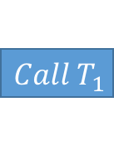

Transaction Ordering Dependence
Transaction Ordering
Atomicity
Expected vs. Eventual State
Attacks
$$Call T_{1}$$
$$Call T_{2}$$
$$State O$$

Slide 16
Timestamp Dependence
Expectation of Current Time
Granularity of timestamp
Influence of Miner

Slide 17
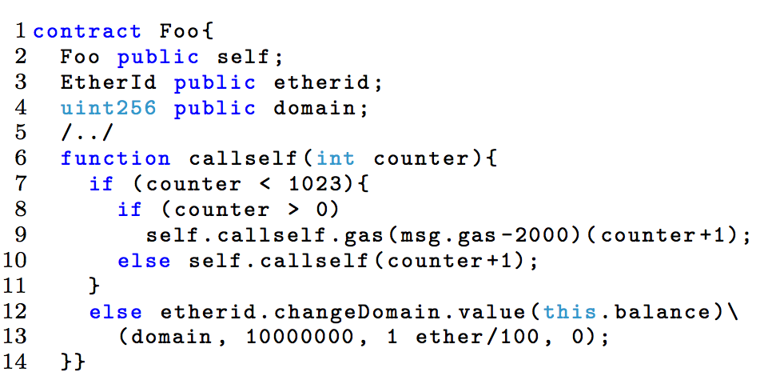
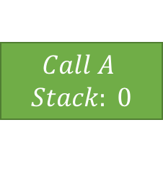
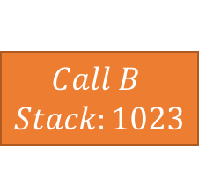
Callstack Attack
Fixed Callstack Size of 1024
Mishandled Exceptions
Execution continues uninterrupted
$$Call A$$
$$Stack: 0$$
$$Call B$$
$$Stack:1023$$

Slide 18
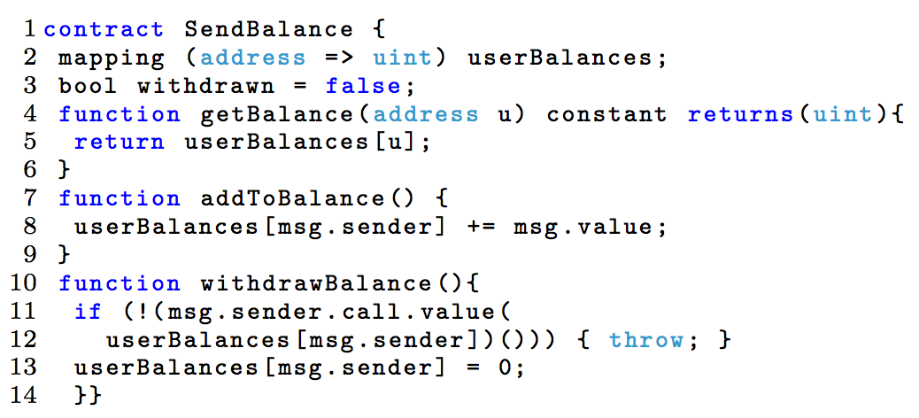
Reentrancy Bug
External Contract Calls
Suspension of Current State
Malicious Exploitation
TheDao Attack

Slide 19
Solution

Slide 20
Architecture
Based on Symbolic Execution
Modular and Extensible
Bytecode
CFG Builder
Visualizer
Ethereum State
Explorer
Core Analysis
Validator
Z3 Bit Vector Solver
Notes:
The Basic architecture of the tool is built around Symbolic Execution. We will explore this in detail on the next slide.
The Architecture is highly modular so as to be extensible. The tool is structured as a number of modules which are as follows:
Contract bytecode is fed to the CFG builder, which builds a skeletal control flow graph of all basic blocks and jumps. The CFG is constructed statically and updated dynamically later on.
The explorer uses the entrypoint from the CFG Builder and the current block state to symbolically evaluate the instructions sequentially from the entrypoint. The explorer queries Z3 as to the feasibility of branches and explores all feasible and reachable instructions.
The Core Analysis module checks for the existence of bugs.
The Validator then attempts a check for false positives. This is far from complete - currently the module checks Z3 to enture that the TOD bugs found by the Core Analysis module are present only in feasible paths.
The Visualizer provides a graphical output for the Control Flow Grap that can aid in manual debugging.
The modular design of the tool allows for easy addition of extension modules to increase test coverage. For example, one proposed addition is a module that can estimate worst-case gas consumption for contracts.

Slide 21
Symbolic Execution
Formulation and Analysis of Path Conditions
Advantages over Dynamic Analysis
Multiple interleaving paths
Exploitable intermediate states
Inputs
Is there any value of x?
T
F
T
T
F
T
F
T
T
Symbolic
Formula
F
T
F
Theorem Prover
NO
YES
Control
Flow Graph
Execution Trace
Notes:
Oyente relies on Symbolic Execution using Z3 to perform the path checks that enable bug detection.
Symbolic execution represent the values of program variables as symbolic expressions of input values, which are then used to statically reason about the feasibility of the paths in a program. This is often faster and more comprehensive to implement tests for than dynamic testing, where a program is tested input-for-input.
For example, consider a single path in a program. The path conditions for this particular path are calculated by evaluating the symbolic values of the variables in this path. Once the execution reaches the end of the path, the path conditions are evaluated to determine whether the path is feasible. Here, the path under analysis is feasible since there is a valid value for x that allows execution.
Symbolic execution also makes it easier to reason about validity of contracts, the analysis of which often involves comparing interleaving paths and the exploitation of intermediate states.

Slide 22
Detection
Transaction Ordering Dependence
Tracking Parallel Flows of Ether
Concurrent flows that affect each other
Timestamp Dependence
Special Symbolic variable for Timestamp
Feasible affected paths
Exception Handling
Bytecode Evaluation
ISZERO present after CALL
Reentrancy Bug
Analysis of Path Conditions upon CALL
Ensuring Repeatability
Examples
Notes:
Oyente implements automated detection for all the bugs discussed.
For Transaction Ordering Dependence, the different paths are analyzed for possibly concurrent Ether flows. If two separate paths have flows of Ether, Oyente reports it as a TOD Contract.
For Timestamp dependence, a special symbolic variable is associated with the timestamp. If there are any feasible paths affected by this variable, it is reprted as timestamp dependent.
Detecting a mishandled exception is done by bytecode analysis. A CALL instruction - which corresponds to a function or contract call, places the return value at the top of the stack. If there is no ISZERO instruction which checks for a valid value, the contract is reported to be have a mishandled exception.
Reentrancy Detection is more complicated. Upon encountering a CALL instruction - a possible point of vulnerability - we obtain the path condition for executing the instruction. We then check if the CALL can be executed again through another call to the contract. If so, this is flagged as a possible vulnerability.

Slide 23

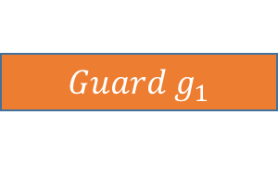


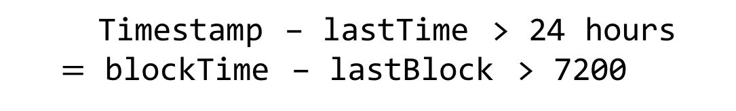
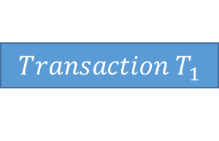
EtherLite
Design
Conformance
Backward Compatibility
Solutions
Guard Conditions
Deterministic timestamp
Better Exception Handling
Lower default GAS values
$$Transaction T_{1}$$
Timestamp – lastTime > 24 hours
$=$ blockTime – lastBlock > 7200
$$g_{1}==true$$
$$TX−STALE$$
$$Guard g_{1}$$
$$TX−SUCCESS$$

Slide 24
Oyénte
Pre-Deployment Checks
Automated Detection
Symbolic Execution using Z3
Pattern Matching

Slide 25
Transaction Ordering Dependence
Tracking Parallel Flows of Ether
Concurrent flows that affect each other
Example

Slide 26
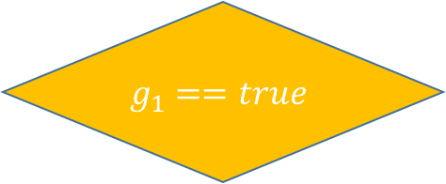
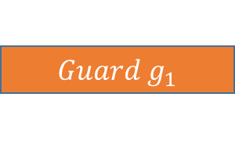


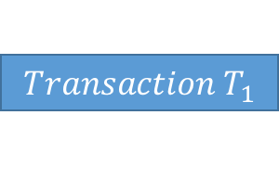
Recommendations
Guard Conditions
Backward-Compatibility
$$Transaction T_{1}$$
$$g_{1}==true$$
$$TX−STALE$$
$$Guard g_{1}$$
$$TX−SUCCESS$$

Slide 27
Timestamp Dependence
Special Symbolic variable for Timestamp
Analyze affected paths
Example

Slide 28
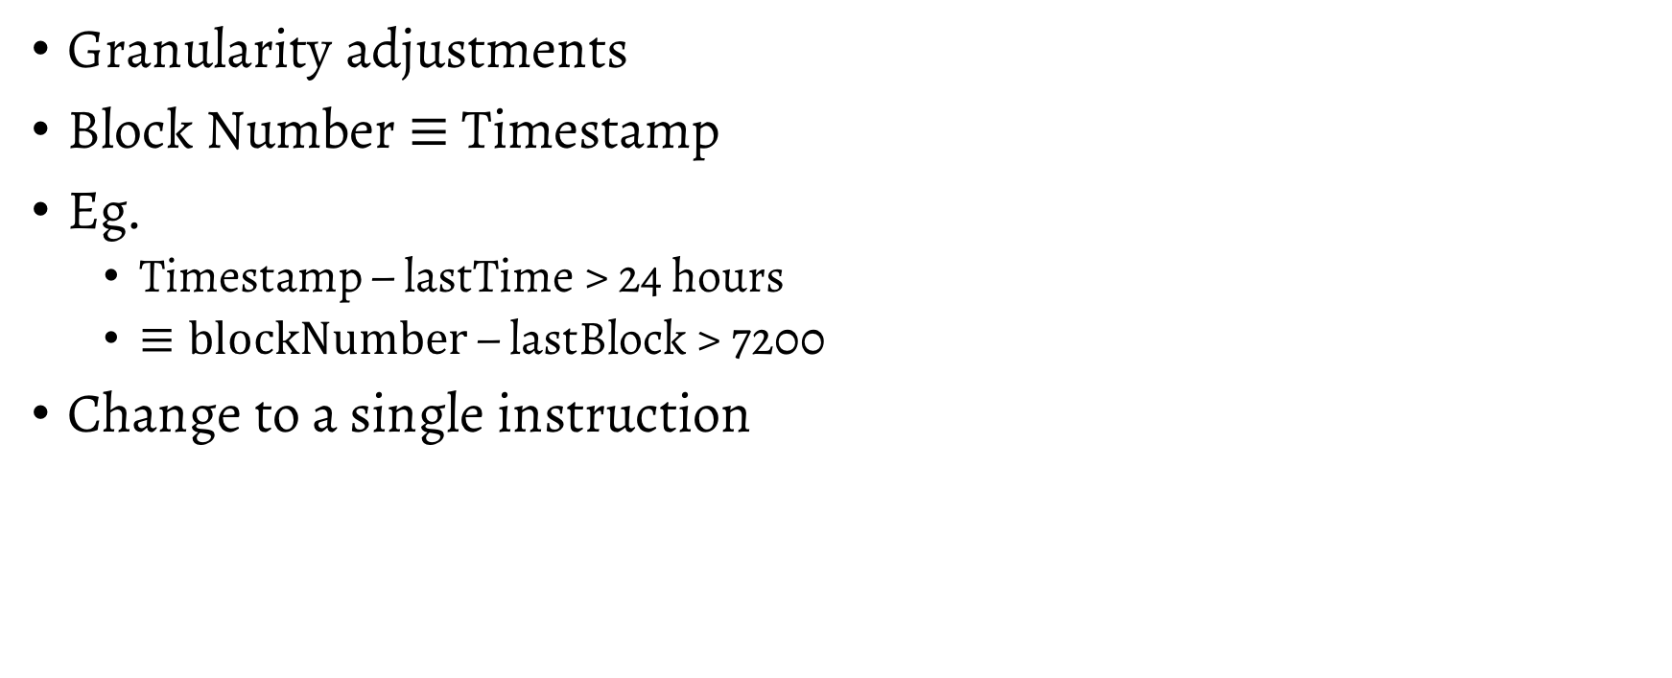
Recommendations
Granularity adjustments
Block Number $≡$Timestamp
Eg.
Timestamp – lastTime > 24 hours
$≡blockNumber$ – lastBlock > 7200
Change to a single instruction

Slide 29
Callstack Attack
Bytecode Evaluation
ISZERO present after CALL
Example

Slide 30
Recommendations
Current Solution
Compiler optimizations
Proposed
EVM-level Exception Forwarding
Enforce exception handling
Eg. Java, Python
Prevent accidental and malicious bugs

Slide 31
Reentrancy Bug
Analysis of Path Conditions upon CALL
Ensuring Repeatability
Example

Slide 32
Recommendations
Quick Solution:
SEND over CALL
Default GAS Restrictions on CALL

Slide 33
Evaluation

Slide 34
Experimental Setup
4 Amazon EC2 m4.x10large instances
40 vCPUs
160 GB RAM
Ubuntu 14.04 64-bit
Z3 v4.4.1
30 minute timeout per contract
1 second timeout per request

Slide 35
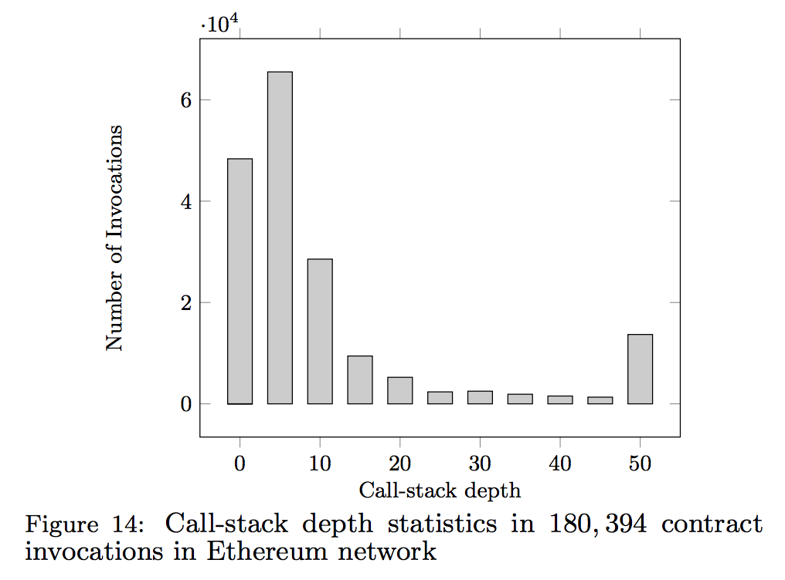
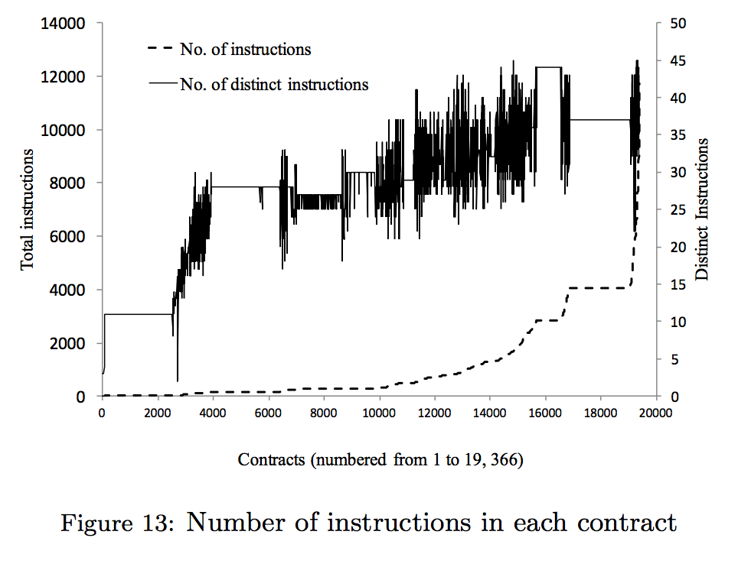
Contract Complexity

Slide 36
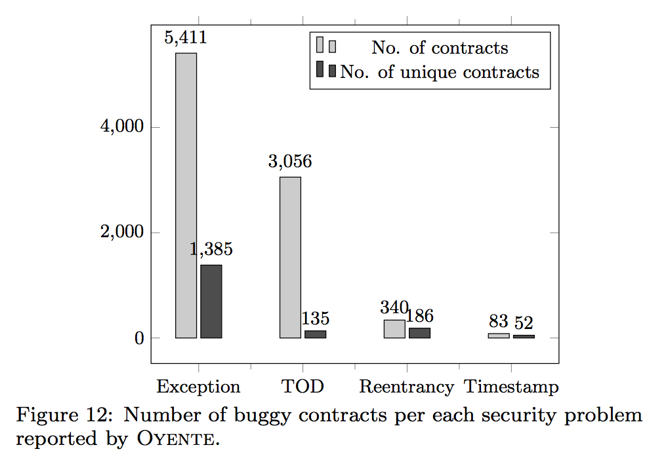
Benchmarks
350 seconds per contract (avg)
8,833 buggy contracts
1,682 distinct
6.4% False Positive (10/175)

Slide 37
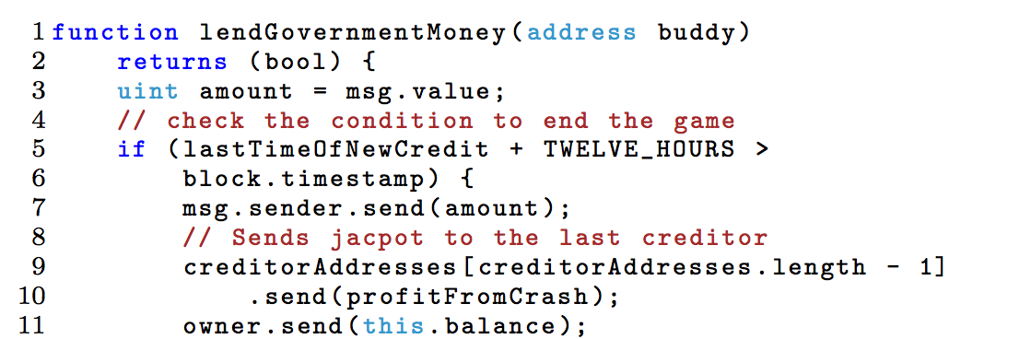
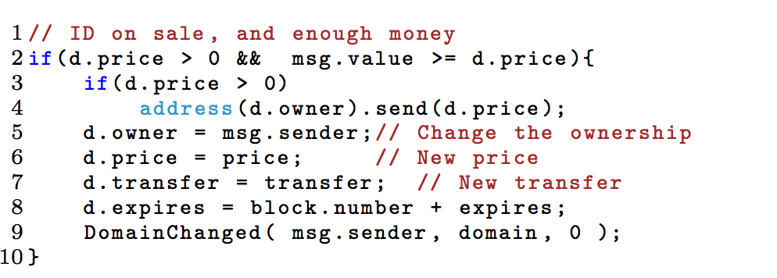
Discovered Attacks
PonziGovernMental
1099.5 Ether (~ 11000 USD)
Stealing Ether
Timestamp Manipulation
EtherID
Locking Ether
~57k Transactions

Slide 38
Miscellaneous Attacks
Non-refundable deposits
Lack of cryptographic security
Incentive Misalignment

Slide 39
Lessons
Improved Languages
Improved Platform
Improved Crypto
Mandatory Static Analysis

Slide 40
Conclusions
Oyente
Smart Contract Analyzer
Automated Bug Detection
Implementation – http://oyente.github.io/benchmarks/
Code – http://github.com/ethereum/oyente
Docker – docker pull hrishioa/oyente
Etherlite
Improved Semantics for Smart Contract Execution
Improved Security on existing source code

Slide 41
Thank You

